Slide 1


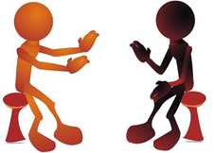

Srishyla Educational Trust (R), Bheemasamudra GM INSTITUTE OF TECHNOLOGY, DAVANGERE (Affiliated to VTU, Belagavi, Approved by AICTE -New Delhi & Govt. of Karnataka) Department Of Information Science and Engineering
Project presentation on
Visual Based Assistance for Differently Abled by Recognizing Sign Language Using Neural Network and Gaussian Blur
Project Guide
Mrs. Nasreen Taj M B
Head of the Department
Dr. Sunil Kumar B S
Project Coordinator
Mr. Firoz Khan
Aishwarya S Yeli [4GM18IS002] | Pavan S Raikar [4GM18IS036]
Nikhitha H B [4GM18IS032] | Pooja K M [4GM18IS037]
Presented By

Slide 2
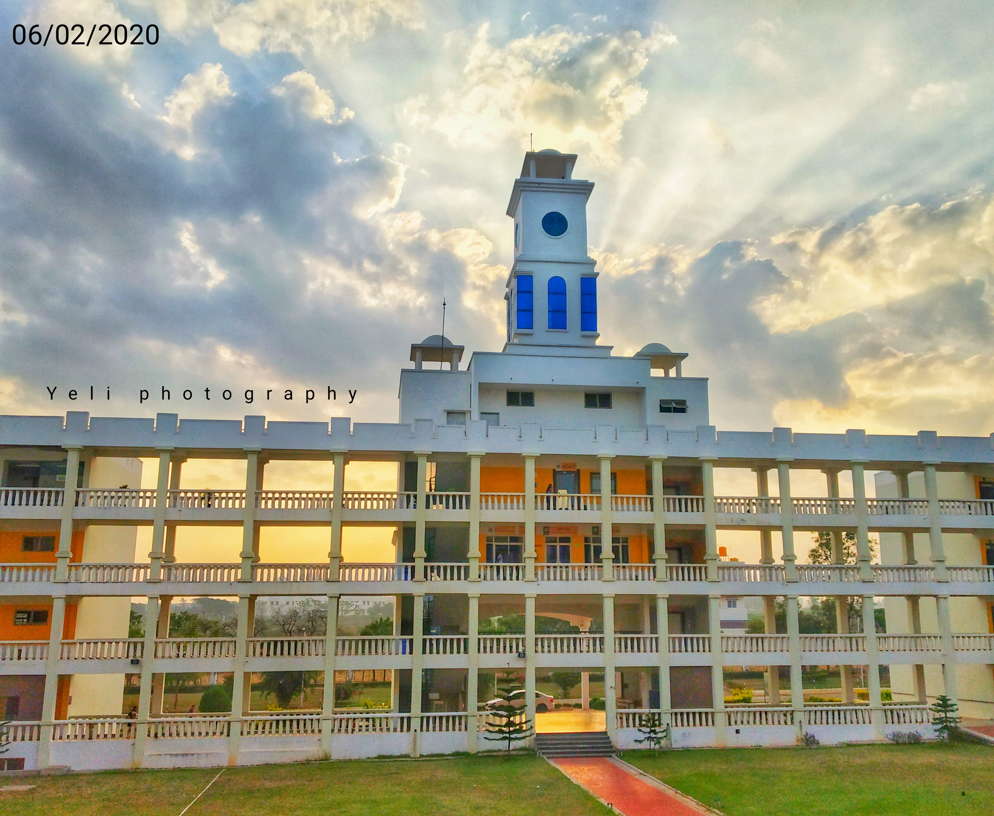
ISE Vision and Mission
Vision
To evolve as an Excellent Technological Education Center of Information Science and Engineering to create competitive & responsible engineering professionals for the advancement of society.
Mission
M1 : To provide Application Specific training and Practical experience for developing Quality Engineers in Information Science and Engineering.
M2 : To Inculcate Creative Skills in students to become Competent in the field of information science and Engineering.
M3 : To Inculcate Professional, Social and Ethical values in student to perform better in diverse environment.
20/04/2022

Slide 3
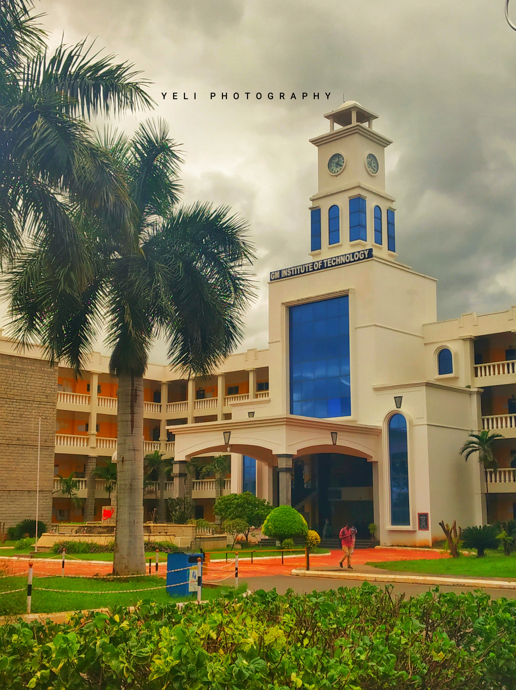
PEOs and PSOs
Program Educational Objectives
To develop graduates who are proficient to solve wide range of computing related problems.
To prepare graduates who have the necessary skills required for Higher Education and Entrepreneurship.
To prepare graduates who have the ability to engage in Lifelong Learning.
Program Specific Outcomes
Capable to design, develop & test the IT Solutions in real time.
Competent to apply knowledge to manage & monitor IT resources
20/04/2022

Slide 4
CONTENTS
ABSTRACT
INTRODUCTION
PROBLEM STATEMENT
OBJECTIVES
SOFTWARE AND HARDWARE REQUIREMENTS
DESIGN
FLOW DIAGRAM
SEQUENCE DIAGRAM
USECASE DIAGRAM
IMPLEMENTATION
TESTING
RESULTS

Slide 5
1
ABSTRACT

Slide 6
ABSTRACT
Sign language is the only tool of communication for the person who is not able to speak and hear anything. Sign language is a boon for the differently abled people to express their thoughts and emotions. In this work, a novel scheme of sign language recognition has been instantiated for identifying the alphabets and numbers sign language. With the help of computer vision and neural networks it can detect the signs and give the respective text output. In this method, the hand is first captured by the camera, then the captured image passed through the trained model and model identifies the sign shown and provides the appropriate output.

Slide 7
2
INTRODUCTION

Slide 8











INTRODUCTION

Slide 9

INTRODUCTION

Slide 10
INTRODUCTION
Three major components of visual language
Fingerspelling | Word level sign vocabulary | Non manual features
Used to spell words letter by letter. | Used for the majority of communication. | Facial expressions and tongue, mouth and body position.

Slide 11
3
PROBLEM STATEMENT
11

Slide 12
PROBLEM STATMENT
Speech impaired people use hand signs and gestures to communicate. Normal people face difficulty in understanding their language. Hence there is a need of a system which recognizes the different signs, gestures and conveys the information to the normal people. It bridges the gap between physically challenged people and normal people.

Slide 13
4
OBJECTIVES
13

Slide 14

OBJECTIVES
To read and analyze the hand gestures.
Extract different features from hand gesture.
To train the machine using convolution neural network.
To provide the accurate output label.

Slide 15
5
SOFTWARE AND HARDWARE REQUIREMENTS
15

Slide 16
SOFTWARE AND HARDWARE REQUIREMENTS
MINIMUM SOFTWARE REQUIREMENTS
Operating System : Microsoft Windows 7
Programming Language : Python 3.6
Software : Anaconda

Slide 17
SOFTWARE AND HARDWARE REQUIREMENTS
MINIMUM HARDWARE REQUIREMENTS
Camera : 3MP
RAM : 4GB
Processor : Intel dual core i3
Processor Speed : 1.0GHz
Hard disk : 20 GB

Slide 18
6
DESIGN

Slide 19
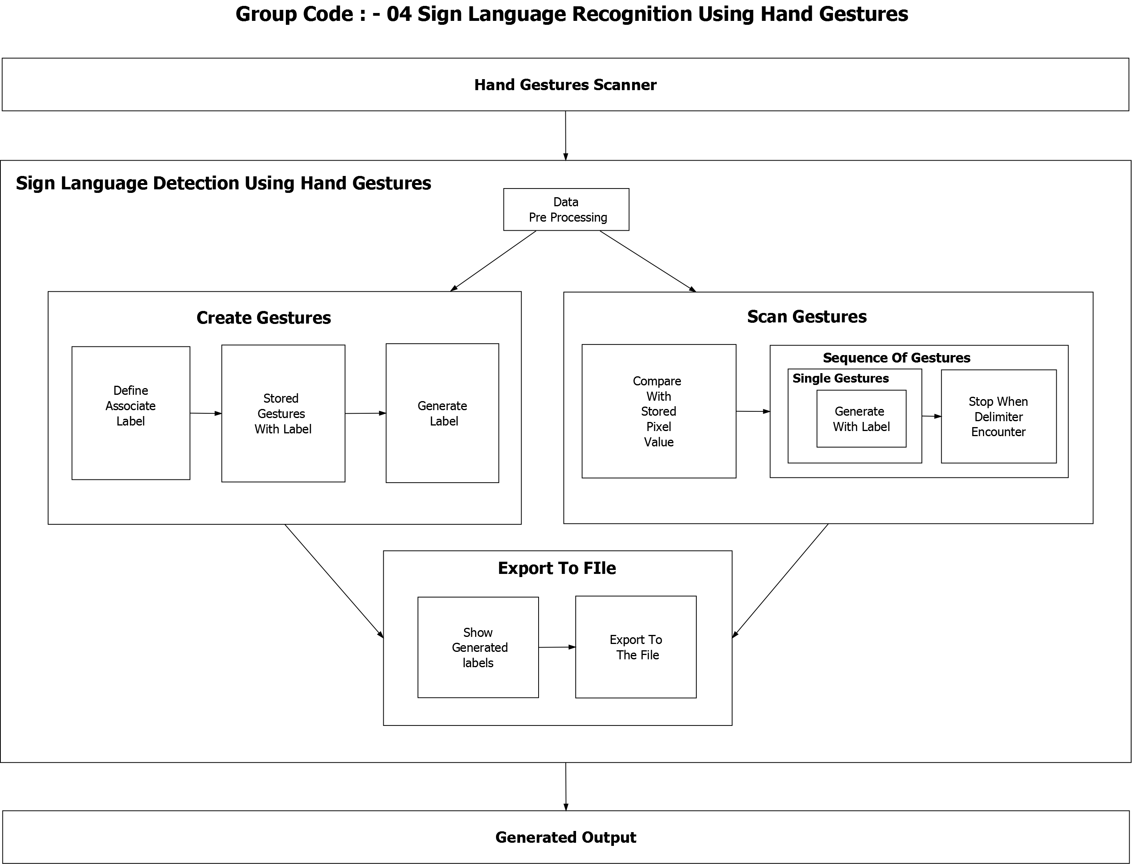
DESIGN - SYSTEM ARHITECTURE

Slide 20
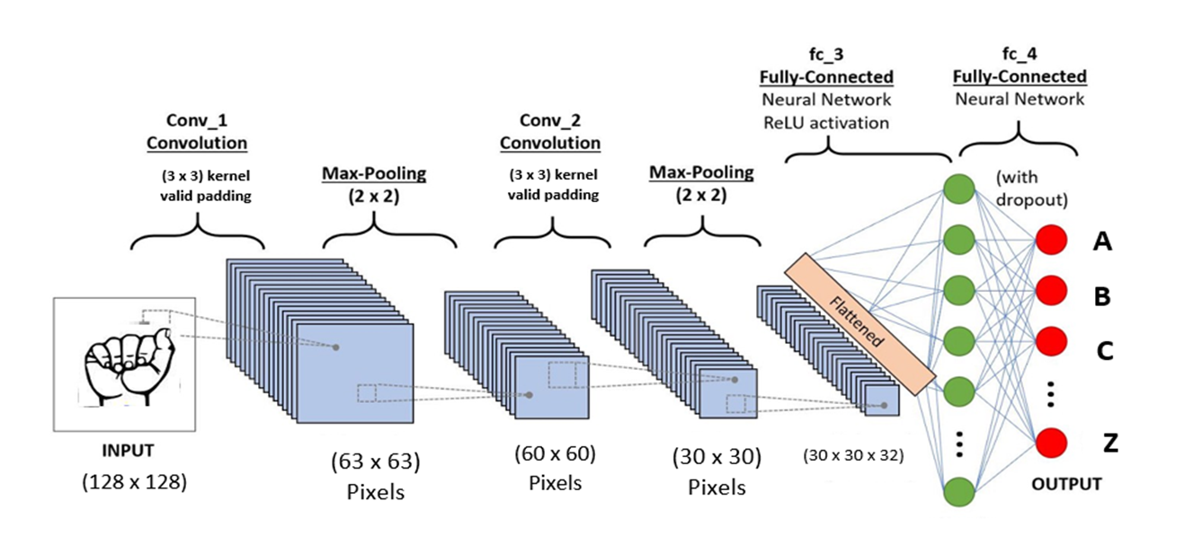
DESIGN – CNN MODEL

Slide 21
7
FLOW DIAGRAM

Slide 22
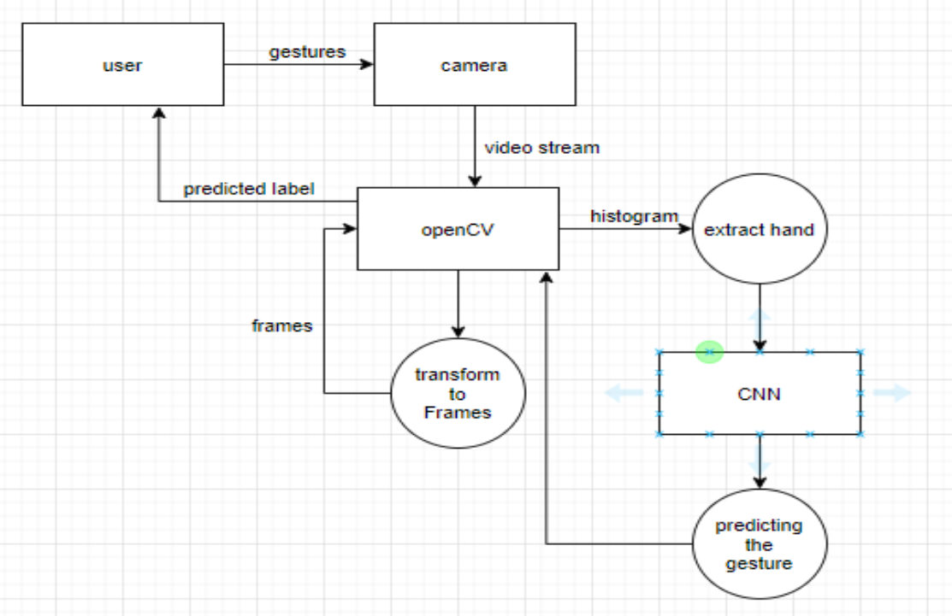
FLOW DIAGRAM

Slide 23
8
SEQUENCE DIAGRAM

Slide 24
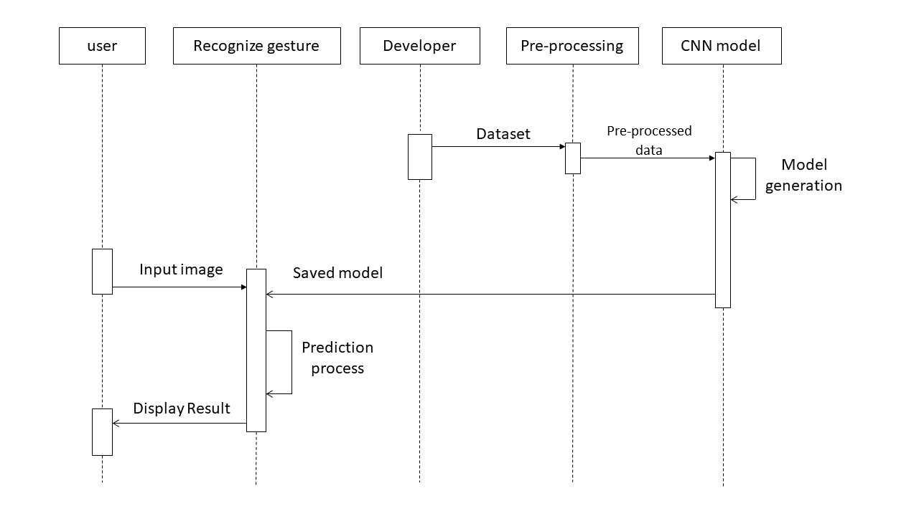
SEQUENCE DIAGRAM

Slide 25
9
USE CASE DIAGRAM

Slide 26
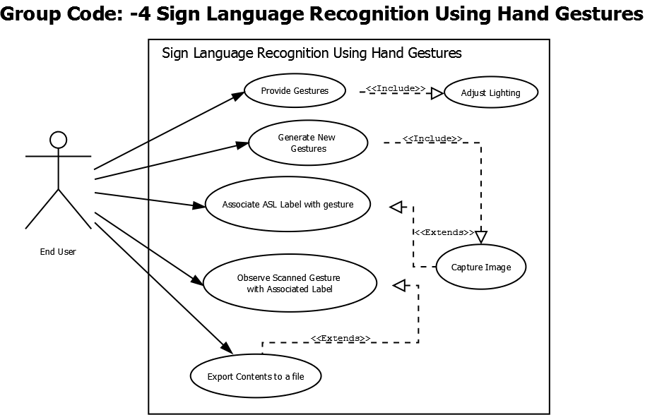
USE CASE DIAGRAM

Slide 27
10
IMPLEMENTATION

Slide 28

IMPLEMENTATION
Software Tools Used

Slide 29

IMPLEMENTATION
Implementation Details
The purpose of this project is to construct a model to output the recognized sign.
Dataset: The Dataset is collected from the Kaggle datasets which consists American sign images of English alphabets.
The following steps are included to build the model.
1. Building CNN model
2. Preprocessing
3. Training
4. Saving the model

Slide 30

IMPLEMENTATION
1. Building CNN Model
classifier.compile(optimizer = optimizers.SGD(lr = 0.01), loss = 'categorical_crossentropy', metrics = ['accuracy’])
2. Pre-processing Data
from keras.preprocessing.image import ImageDataGenerator train_datagen = ImageDataGenerator( rescale=1./255, shear_range=0.2, zoom_range=0.2, horizontal_flip=True)test_datagen = ImageDataGenerator(rescale=1./255)

Slide 31

IMPLEMENTATION
3. Training
training_set = train_datagen.flow_from_directory( 'Dataset/training_set', target_size=(64, 64), batch_size=32, class_mode='categorical’)
model = classifier.fit_generator( training_set, steps_per_epoch=800, epochs=25, validation_data = test_set, validation_steps = 6500)

Slide 32

IMPLEMENTATION
4. Saving the model
import h5py
classifier.save('Trained_model.h5')

Slide 33
IMPLEMENTATION
Converting Colored image to Gaussian blur image
Frame is taken from the image and value is returned from getting the camera frame, either true of false
Resizing of image is done
BGR is converted to RGB
Rectangle is created using cv2. rectangle()

Slide 34
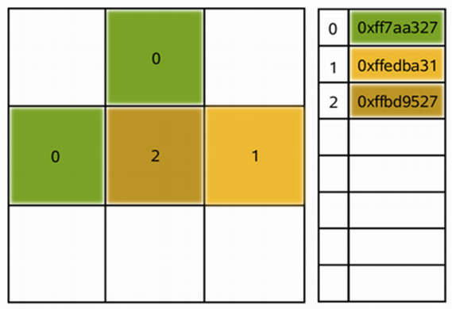
IMPLEMENTATION
Converting Colored image to Gaussian blur image
Image is converted to qimage
Qimage is image representation that allows direct access to the pixel data
QPixmap can be used to show an image in the window

Slide 35
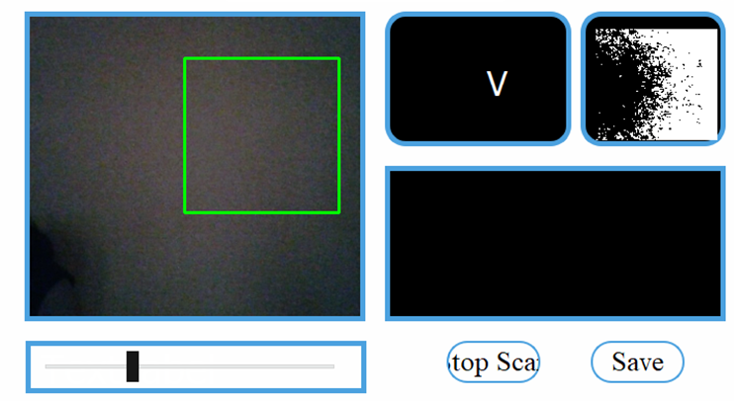
IMPLEMENTATION
Converting Colored image to Gaussian blur image
Trackbars are created by specifying value property
Removal of blue background
Converting bgr image to hsv image
Threshold the HSV image
Denote the lower and upper boundary of the threshold region

Slide 36
IMPLEMENTATION
Prediction of Sign
SIFT Algorithm:
Step 1: Loads image
Step 2: Converts Python Imaging Library Image instance to a Numpy array
Step 3: Keypoints and computing descriptors are extracted using the Scale Invariant Feature Transform

Slide 37
IMPLEMENTATION
Prediction of Sign
Step 4: Sift object is created, and comparison of original image and image to compare is done
Step 5: FlannBasedMatcher is loaded to find the matches
Step 6: The array named matches will contain all possible matches, so many false matches as well
Step 7: The ratio test is applied to select only the good matches. It selects only the matches with lower distance, so higher quality

Slide 38
11
TESTING

Slide 39
UNIT TESTING
Sl No. | Test Case | Expected Output | Actual Output | Remarks
1 | Web Cam | Active | Active | Pass
2 | Detection of Hand | Detects the hand in ROI | Detects the hand in ROI | Pass
3 | Capturing of Sign | Captures and saves | Captures and saves | Pass

Slide 40
UNIT TESTING
Sl No. | Test Case | Expected Output | Actual Output | Remarks
4 | Scan Gesture | Detects & Scan | Detects & Scan | Pass
5 | Scan Sentences | Detects & Scan | Detects & Scan | Pass
6 | Export File | Exports to System Files | Exports to System Files | Pass

Slide 41
INTEGRATION TESTING
Sl No. | Test Case | Expected Output | Actual Output | Remarks
1 | Hand capture | Hand in ROI | Hand in ROI | Pass
2 | Sign detection | Successful | Successful | Pass

Slide 42
SYSTEM TESTING
Sl No. | Testing | Expected Output | Actual Output | Remarks
1 | Using the available resources which help to obtain expected results | Runs as expected | Runs as expected | Pass
2 | OS Compatibility | Performance is good in windows 7 | Performance is good in windows 7 | Pass

Slide 43
12
RESULTS

Slide 44
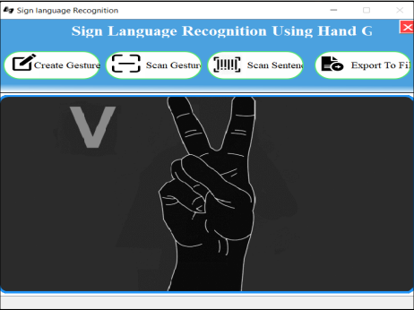
RESULTS
Dashboard

Slide 45
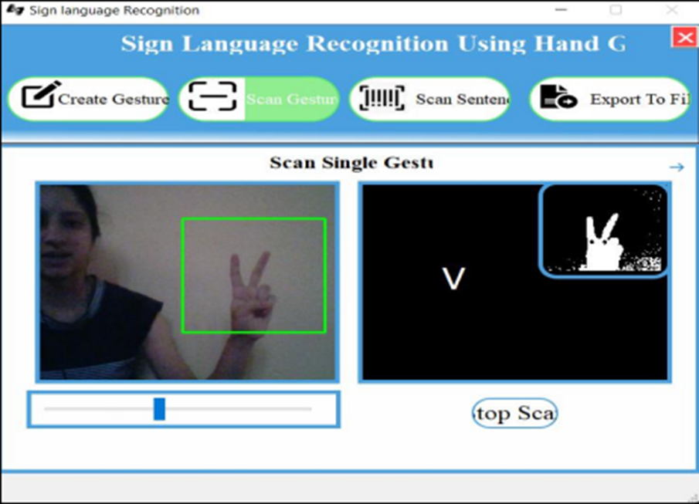
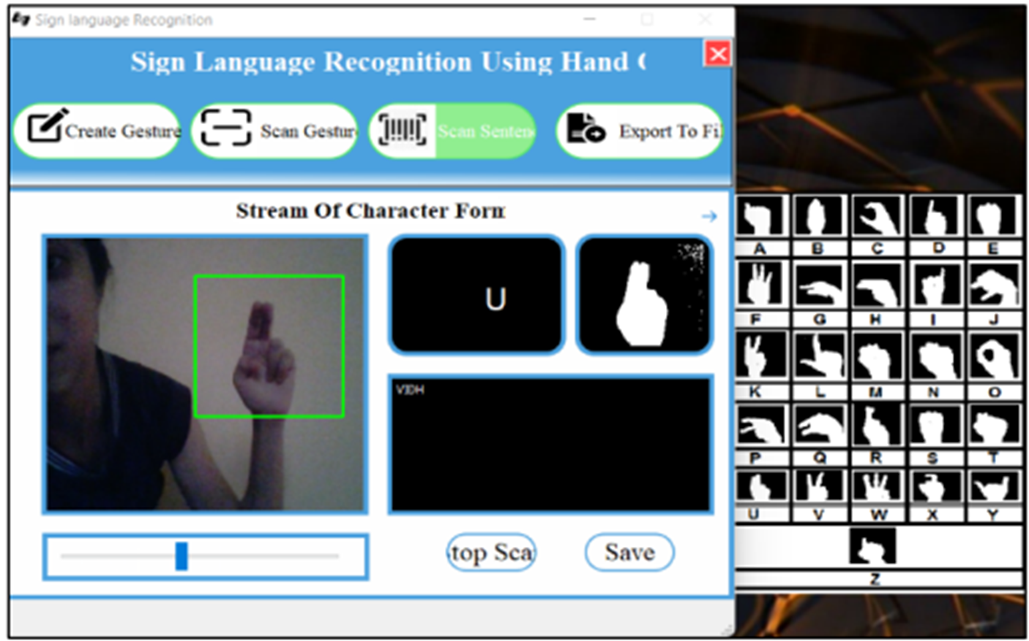
RESULTS
Scan Gesture
Scan Sentence

Slide 46
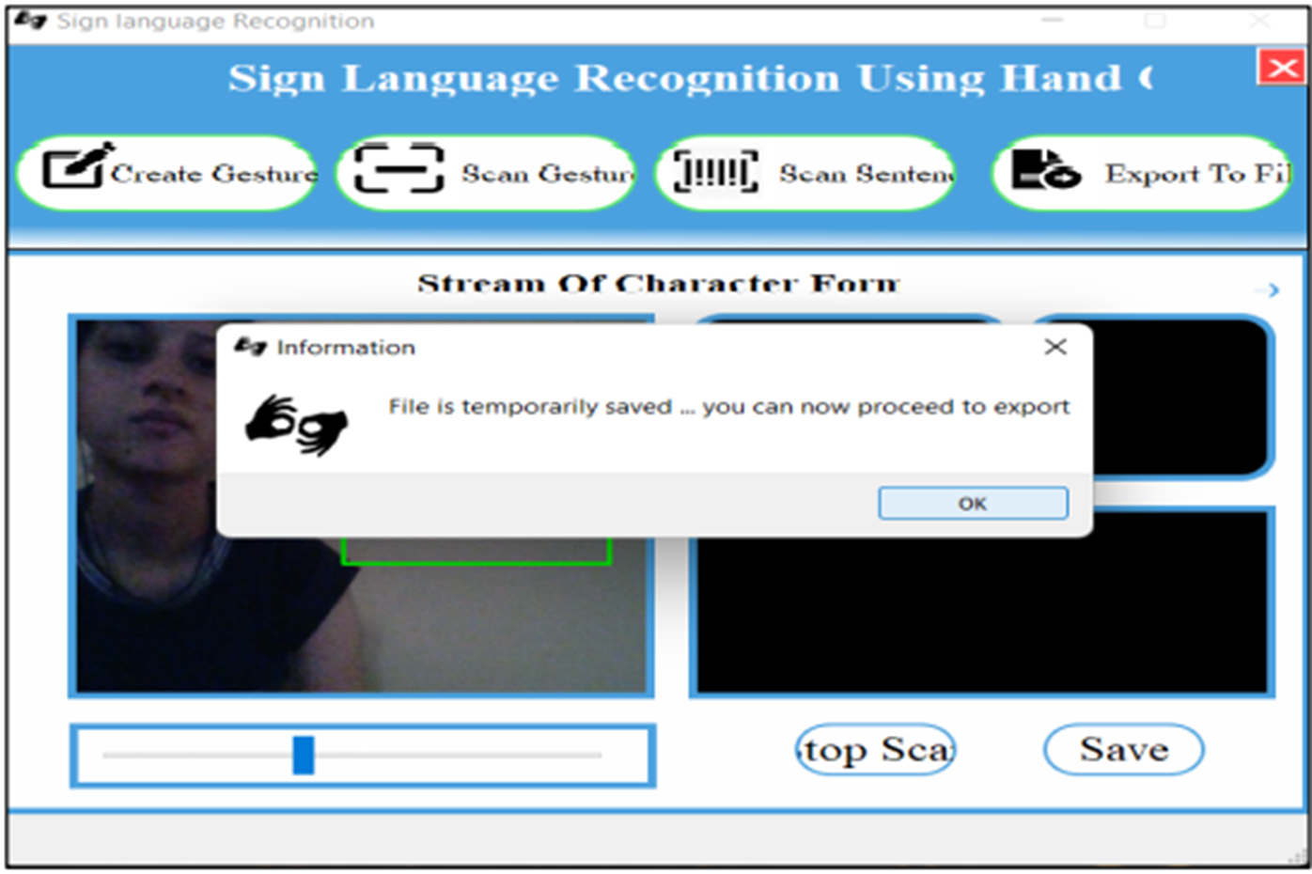
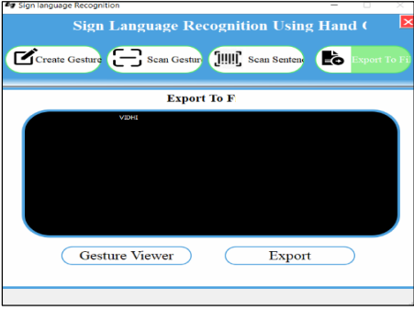
RESULTS
Save
Export to File

Slide 47
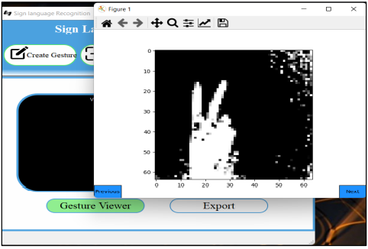
RESULTS
Gesture View

Slide 48


